Slide 1
Data Science/Analytics Basics
Aniket Chhabra

Slide 2

Welcome to Stats Refresher Session…
“There are three types of lies -- lies, damn lies, and statistics.”
“Facts speak louder than statistics”
“All Statistical models are wrong…. Some models are useful”
“99 percent of all statistics only tell 49 percent of the story”
“I can prove anything by statistics except the truth..”
“Facts are stubborn, but statistics are more pliable..”
“Statistics are used much like a drunk uses a lamppost: for support, not illumination”

Slide 3
Statistics…Probability….And….!!!
A statistics professor plans to travel to a conference by plane. When he passes the security check, they discover a bomb in his carry-on-baggage. Of course, he is hauled off immediately for interrogation.
"I don't understand it!" the interrogating officer exclaims. "You're an accomplished professional, a caring family man, a pillar of your parish - and now you want to destroy that all by blowing up an airplane!"
"Sorry", the professor interrupts him. "I had never intended to blow up the plane."
"So, for what reason else did you try to bring a bomb on board?!"
"Let me explain. Statistics shows that the probability of a bomb being on an airplane is 1/1000. That's quite high if you think about it - so high that I wouldn't have any peace of mind on a flight."
"And what does this have to do with you bringing a bomb on board of a plane?"
"You see, since the probability of one bomb being on my plane is 1/1000, the chance that there are two bombs is 1/1000000. If I already bring one, the chance of another bomb being around is actually 1/1000000, and I am much safer..."

Slide 4
We are Thankful to….
Courseera.org - Data Analysis and Statistical Inference (Dr. Mine Çetinkaya - Rundel – Duke University)
Basic Econometrics, Fourth Edition – Dr. Damodar Gujarati
Fundamentals of Mathematical Statistics – S.C. Gupta and V.K.Kapoor
Fundamentals of Statistics - Goon A M, Gupta M K, B. Dasgupta
Statistical Methods – N.G.Das
All our Professors and Teachers and Friends and colleagues…
Last But Not Least – the Internet

Slide 5
Course Scope….
Data Basic
Sampling and Sources of bias
Central Tendency
Measure of Spread
Visualizing Numeric Data
Data Transformation
Exploring Categorical Variables
Concept of Probability
Normal Distribution, Binomial and Poison Distribution
Central Limit Theorem
Confidence Interval
Hypothesis Testing
One Sided – Two Sided Tests
Chi-Square and Other Test
Correlation & Introduction to Regression
Workbook

Slide 6
Data Basics…
All Variables
Numerical
Continuous
Discrete
Categorical
Regular Categorical
Ordinal
Cross Sectional Data
Its is a collection of observations(behavior) for multiple subjects(entities) at single point in time.
Max Temperature, Humidity and Wind( all three behaviors) in New York City, SFO, Boston, Chicago(multiple entities) on 1/1/2015(single instance)
Cross Sectional Data
It is a collection of observations(behavior) for a single subject(entity) at different time intervals(generally equally spaced)
Max Temperature, Humidity and Wind( all three behaviors) in New York City(single entity) collected on First day of every year(multiple intervals of time)
Panel Data
It is usually called as Cross-sectional Time-series data as it a combination of above mentioned types, i.e., collection of observations for multiple subjects at multiple instances
Max Temperature, Humidity and Wind( all three behaviors) in New York City, SFO, Boston, Chicago(multiple entities) on First day of every year(multiple intervals of time)
Notes:
https://www.youtube.com/watch?v=Coe0N2xb8kk (Understanding Types of Data)
https://www.youtube.com/watch?v=LPHYPXBK_ks (How to Remember the differences)
https://www.youtube.com/watch?v=oHGr0M3TIcA (The Basics: Descriptive and Inferential Statistics)

Slide 7
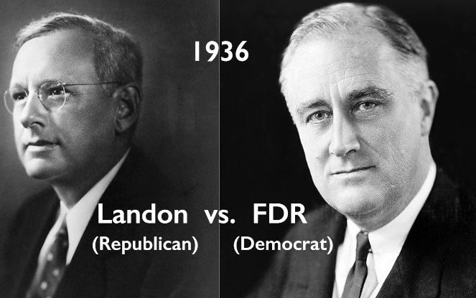

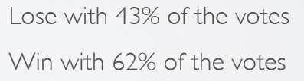
Population, Sample and Sources of Bias
Population : A population includes each element from the set of observations that can be made.
E.g. MNC Employees residing in Bangalore, All Honda cars manufactured in 2014.
Sample : A sample consists only of observations drawn from the population.
E.g. Fidelity Employees from EGL and Manyata, Honda City manufactured in Q2 of 2014.
In statistics & survey methodology, sampling is concerned with the selection of a subset of individuals (sample) from within a statistical population to estimate characteristics of the whole population.
In cases, when the universe (population) is very large, then the sampling method is the only practical method for collecting the data. It is economical, scientific and consumes less time.
Disadvantages of sampling
Chances of introducing sampling bias.
Sampling Error.
Will never be an exact representation of the population.
Some Sources of Sampling Bias
Convenience sample: Individuals who are easily accessible are more likely to be included in the sample
Non-Response: If only a (non-random) fraction of the randomly sampled people respond to a survey such that the sample is no longer representative of the population.
Voluntary Response : Occurs when the sample consists of people who volunteer to respond because they have strong opinions on the issue
Notes:
https://www.youtube.com/watch?v=VtGYaYW-tAk (Population and Sample)
https://www.youtube.com/watch?v=gF-XOHRX7wk (Parameter and Statistics (1/2))
https://www.youtube.com/watch?v=1o6N8Q2rOYA (Parameter and Statistics (2/2))

Slide 8
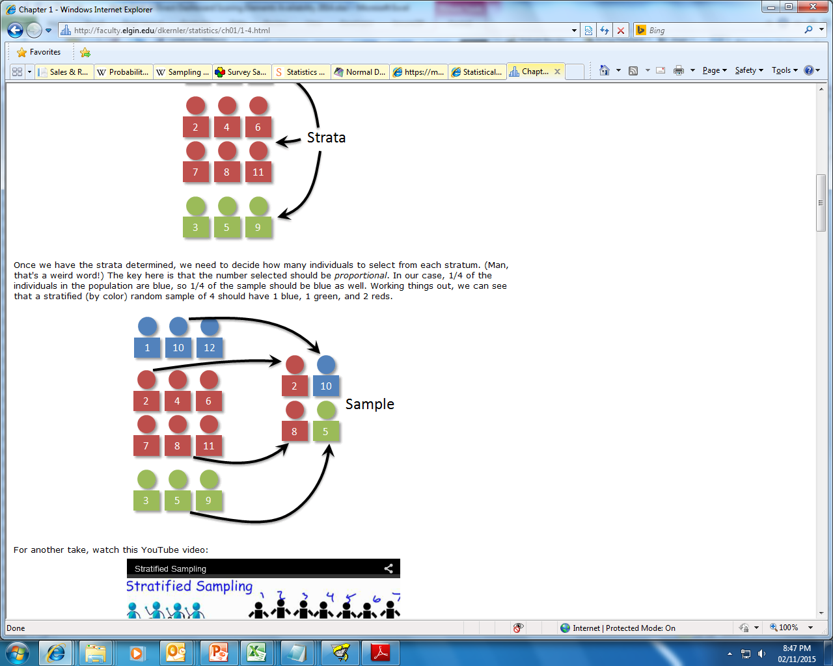
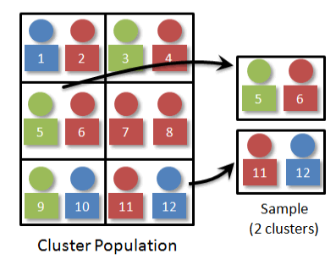
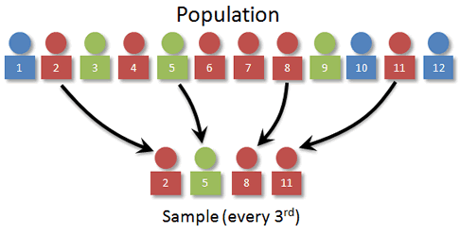
Popular Sampling Methods
Simple random sampling is the simplest form of sampling. Each member of the population has an equal and known chance of being selected.
Systematic sampling is often used instead of random sampling. It is also called an Nth name selection technique. This involves a random start and then proceeds with the selection of every k’th element from then onwards. In this case, k=(population size/sample size).
Stratified sampling is commonly used probability method that is superior to random sampling because it reduces sampling error. A stratum is a subset of the population that share at least one common characteristic. Examples of stratums might be males and females, or managers and non-managers. The researcher first identifies the relevant stratums and their actual representation in the population. Random sampling is then used to select a sufficient number of subjects from each stratum. "Sufficient" refers to a sample size large enough for us to be reasonably confident that the stratum represents the population. Stratified sampling is often used when one or more of the stratums in the population have a low incidence relative to the other stratums.
Cluster sampling is a sampling technique where the entire population is divided into groups, or clusters, and a random sample of these clusters are selected. All observations in the selected clusters are included in the sample.
Notes:
https://www.youtube.com/watch?v=be9e-Q-jC-0 (Sampling)
https://www.youtube.com/watch?v=yx5KZi5QArQ (Simple Random Sampling)

Slide 9
Central Tendency – Measure of Centre
Category | Description | Advantage | Disadvantage | Example
Mean (Arithmetic Mean) | The arithmetic mean of a set of data is found by taking the sum of the data, and then dividing the sum by the total number of values in the set. A mean is commonly referred to as an average. | Simple to Understand/explain Takes every value into account. | Affected by extreme values | Mean of the series 1-10 would be (1+2+…10)/10 = 5.5
Median | The median of a finite list of numbers can be found by arranging all the observations from lowest value to highest value (or highest to lowest) and picking the middle one. | Finds the middle number of a set of data, so outliers have little or no effect | If the gap between some numbers is large, while it is small between other numbers in the data, this can cause the median to be a very inaccurate way to find the middle of a set of values. | Case 1 – Median of the series (1-11) would be - 6 Case-2 – Median of the series (1-10) would be (5+6)/2 =5.5
Mode | The mode is the value that occurs most frequently in a data set | Allows you to see what value happened the most in a set of data. This can help you to figure out things in a different way. It is also quick and easy. | Could be very far from the actual middle of the data. The least reliable way to find the middle or average of the data. | Example 1 –(1,2,3,4,4,5) - Mode 4 Example 2 – (1,2,2,3,3,4) – Mode 2,3 Example 3 – (1,1,2,2,3,3) – No Mode
USAGE: Incase the dataset contains outliers, it is suggested that one uses Median instead of Mean as the average reported could be highly skewed by outliers, but again it depends on how we use this data.
E.g. College placement committee would want to lure students by reporting mean salary received by its students but a student seeking admission should consider median as the average reported could be biased by couple of highly compensated international placements.
Notes:
https://www.youtube.com/watch?v=fqFiXQN_y_k (Measure of Central Tendency)
https://www.youtube.com/watch?v=XVP4seIzW-U (Choosing the Best Measure of Central Tendency)

Slide 10
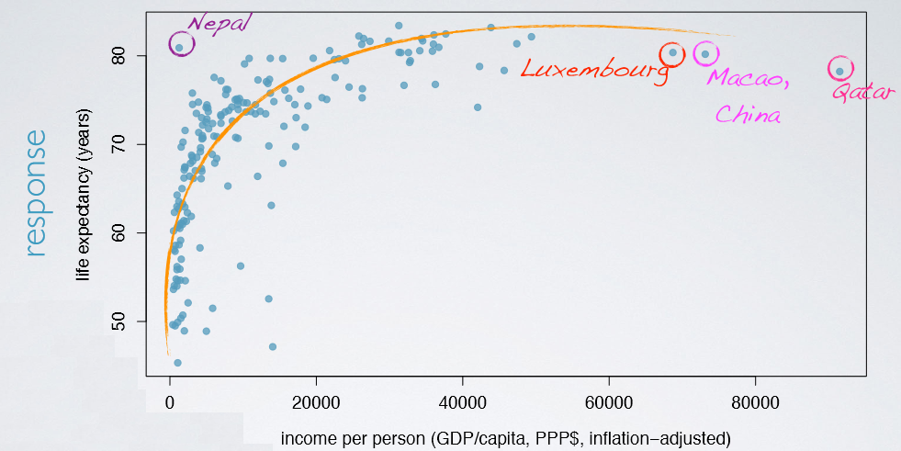

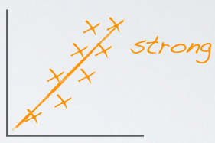
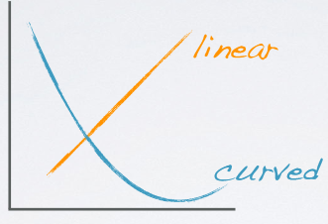
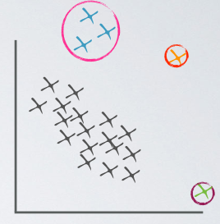
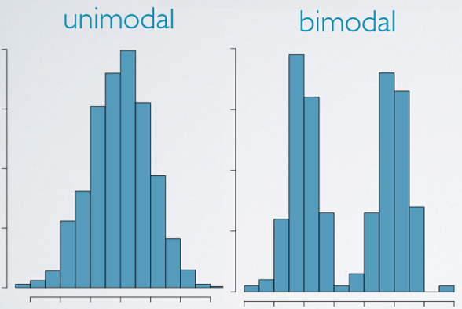
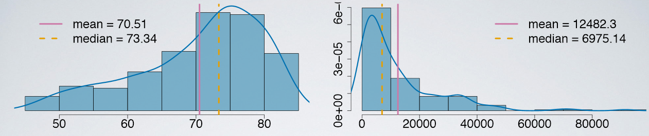
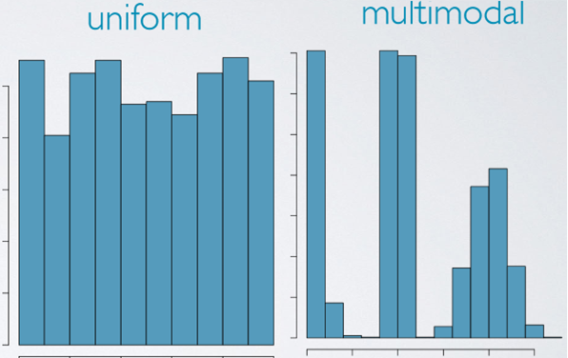
Working on Numerical Data…And Visualizing…!!!

Slide 11
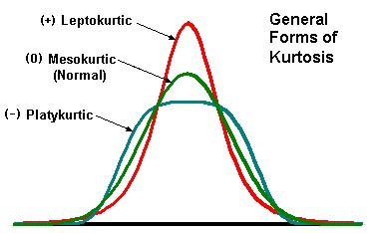
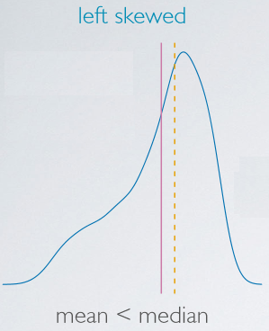
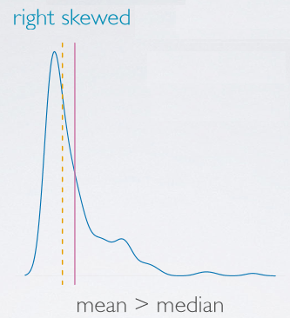
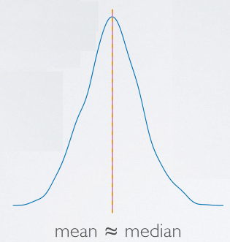
Skewness and Kurtosis!
Skewness: It is the degree of departure from symmetry of a distribution.
•Skewness > 0 - Right skewed distribution - most values are concentrated on left of the mean, with extreme values to the right.
•Skewness < 0 - Left skewed distribution - most values are concentrated on the right of the mean, with extreme values to the left.
•Skewness = 0 - mean = median, the distribution is symmetrical around the mean.
Kurtosis: It is the degree of peakedness of a distribution.
•Kurtosis > 3 - Leptokurtic distribution, sharper than a normal distribution, with values concentrated around the mean and thicker tails. This means high probability for extreme values.
•Kurtosis < 3 - Platykurtic distribution, flatter than a normal distribution with a wider peak. The probability for extreme values is less than for a normal distribution, and the values are wider spread around the mean.
•Kurtosis = 3 - Mesokurtic distribution - normal distribution for example.
Pattern | Distribution
Mean < Median | Left Skewed
Mean > Median | Right Skewed
Mean = Median | Symmetric
Notes:
https://www.youtube.com/watch?v=lBuJmzyiu8Y (Skewness)
https://www.youtube.com/watch?v=Nhlof2T-tV4 (Kurtosis)

Slide 12
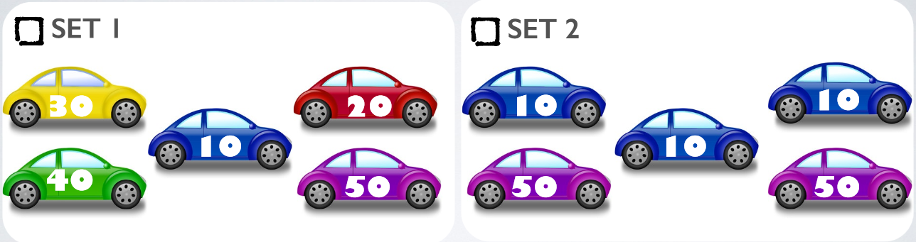
Dispersion – Measure of Spread
Range: The difference between the largest and the smallest value in the dataset. Since the range only takes into account two values from the entire dataset, it may be heavily influenced by outliers in the data.
Interquartile range : Distance between the 25th and 75th percentiles (Q3 - Q1). By definition, this contains 50% of the data points in a dataset.
Mean Deviation: The average of the absolute values of the differences between individual numbers and their mean.
Standard deviation (represented by the symbol σ): shows how much variation or "dispersion" exists from the average (mean, or expected value). A low standard deviation indicates that the data points tend to be very close to the mean, whereas high standard deviation indicates that the data points are spread out over a large range of values. The square of SD is know as Variance.
Coefficient of Variation: It’s a relative measure. The formula is (SD/Mean)*100
Which of the following sets of cars has a more diverse composition of colors?
Which of the following sets of cars has more variable mileage?
Notes:
https://www.youtube.com/watch?v=Snf6Wpn-L4c (Percentiles and Quartiles)
https://www.youtube.com/watch?v=gp_fUdPXpG4 (Measure of Dispersion)
https://www.youtube.com/watch?v=92s7IVS6A34 ( N for Population vs. N-1 for Sample Explained)
https://www.youtube.com/watch?v=9ONRMymR2Eg

Slide 13

Probability Theory
Probability theory is the branch of mathematics concerned with the analysis of random phenomena/process.
Random Process : Random processes (and variables) talk about quantities and signals which are unknown in advance. In a random process we know what outcomes could happen, but we don’t know which particular outcome will happen.
Random Variable, is a variable whose possible values are numerical outcomes of a random phenomenon. There are two types of random variables, discrete and continuous.
Probability: Probability is the measure of the likeliness that an event will occur. Probability is quantified as a number between 0 and 1 (where 0 indicates impossibility and 1 indicates certainty).
Trial: Any particular performance of a random experiment is called a trial.
E.g.: Rolling a die, Running a Direct Mail campaign
Experiment: This is considered to be a larger entity formed by the combination of a number of trials.
E.g.: A game of a 3 coin tosses, Pick a random card from a deck and roll a die.
Event/Outcome: A result that is caused by some previous action. The results or outcomes or observations of an experiment are called events.
E.g.: Appearance of six in the roll of a die, # of responders in a campaign
Notes:
https://www.youtube.com/watch?v=usY1oY0bWQ8 (Introduction to Probability)

Slide 14
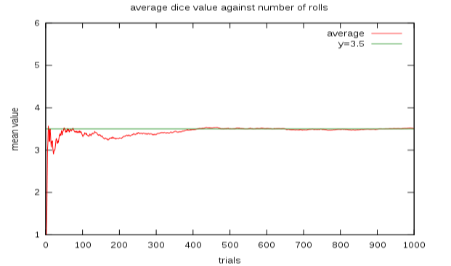
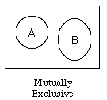
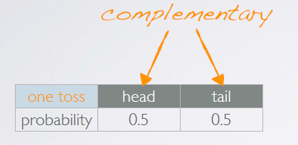
Concepts Related to Probability Theory
Law of Large Numbers:
According to this law, the average of the results obtained from a large number of trials should be close to the expected value, and will tend to become closer as more trials are performed.
E.g.: If a large number of six-sided dice are rolled, the average of their values (sometimes called the sample mean) is likely to be close to 3.5, with the precision increasing as more dice are rolled.
Sample Space: This is a collection of all possible outcomes of a trial.
Mutually Exclusive/Disjoint Events: Events are said to be mutually exclusive or disjoint when
the occurrence of one of the events is not associated with the occurrence of the other(s).
Independent Events: A set of events are independent if knowing the outcome of one provides
no useful information about the outcome of the other.
Complementary Events: Complementary events are two mutually exclusive events
whose probabilities add up to 1.

Slide 15
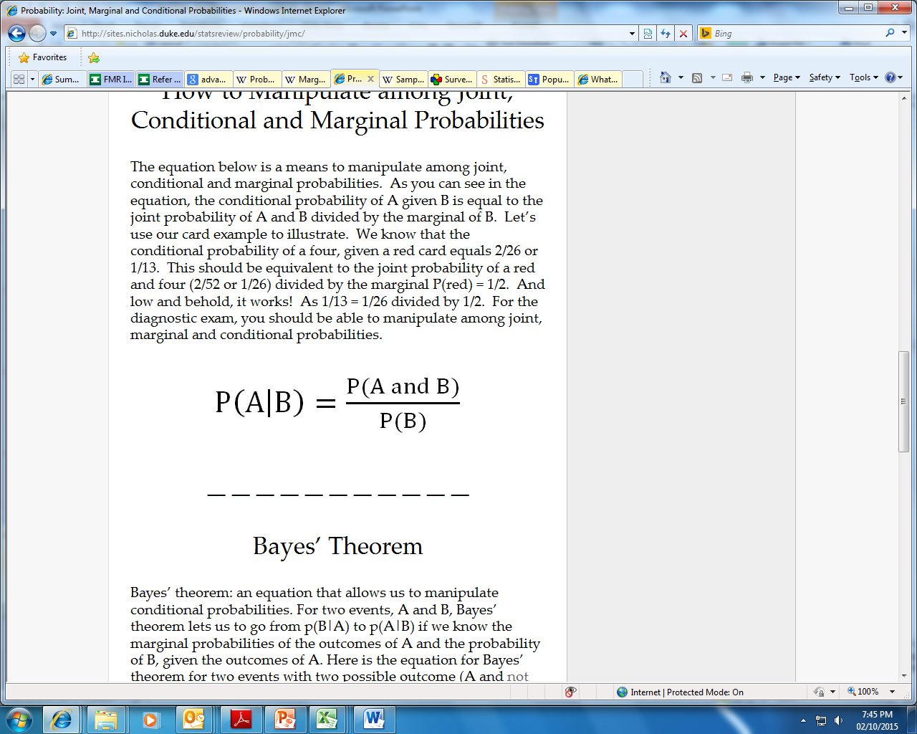
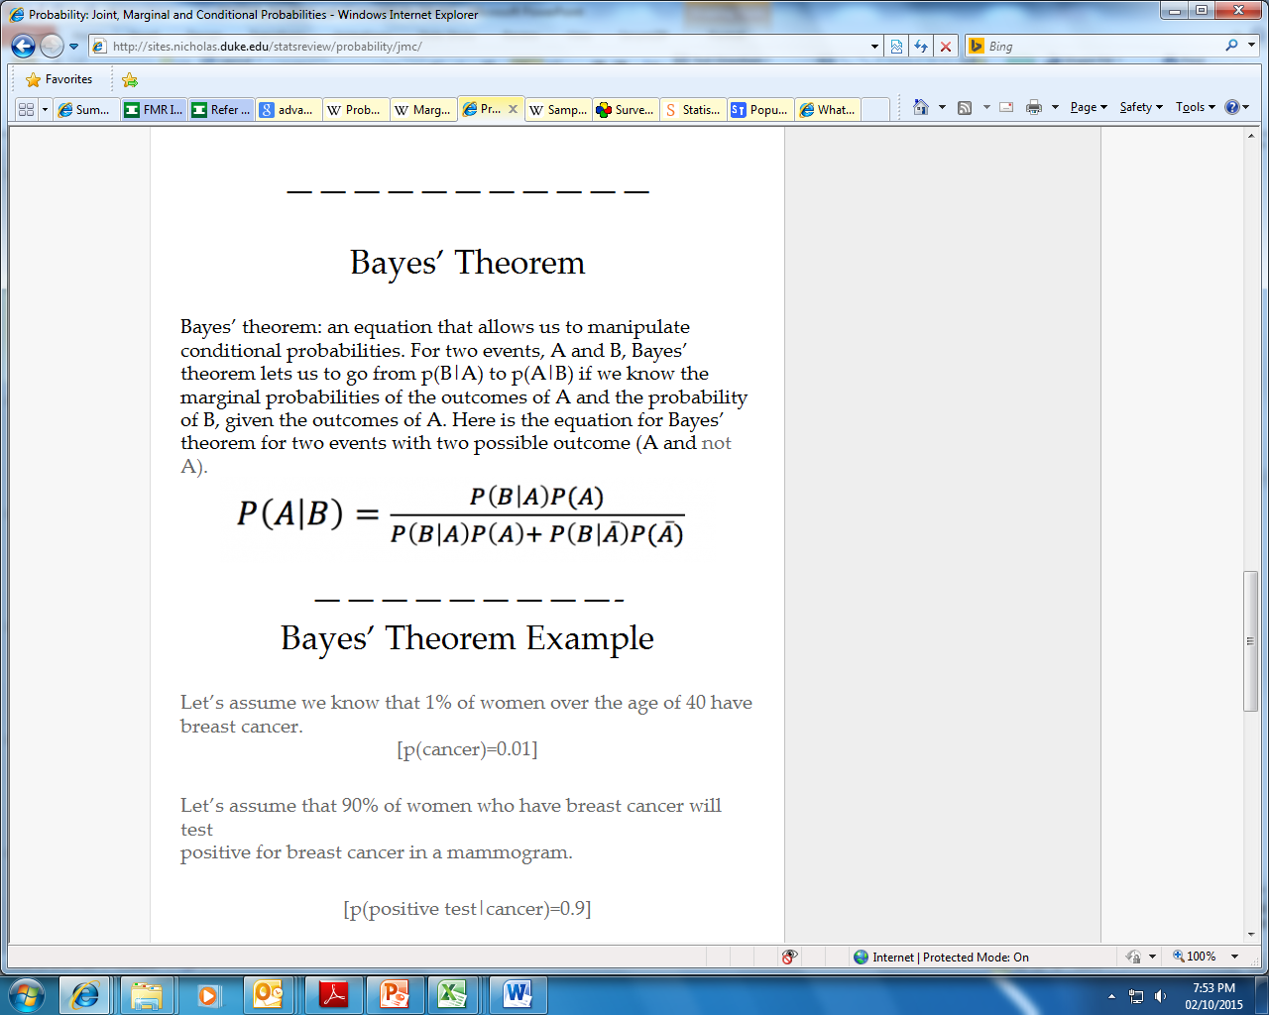
Continued Concepts….Marginal, Joint, Conditional Probabilities
Simple or Marginal probability: The probability of an event occurring (p(A)), which is not conditioned on another event. Example: the probability that a card drawn is red (p(red) = 0.5). Another example: the probability that a card drawn is a 4 = (p(four)=1/13).
Joint probability: p(A and B) The probability of event A and event B occurring. It is the probability of the intersection of two or more events. The probability of the intersection of A and B may be written p(A ∩ B). Example: the probability that a card is a four and red =p(four and red) = 2/52=1/26. (There are two red fours in a deck of 52, the 4 of hearts and the 4 of diamonds).
Conditional probability: p(A|B) is the probability of event A occurring, given that event B occurs. Example: given that you drew a red card, what’s the probability that it’s a four (p(four|red))=2/26=1/13. So out of the 26 red cards (given a red card), there are two fours so 2/26=1/13.
The conditional probability of A given B is equal to the joint probability of A and B divided by the marginal of B.
Bayes’ theorem: An equation that allows us to manipulate conditional probabilities. For two events, A and B, Bayes’ theorem lets us to go from p(B|A) to p(A|B) if we know the marginal probabilities of the outcomes of A and the probability of B, given the outcomes of A.
Notes:
https://www.youtube.com/watch?v=H02B3aMNKzE (Conditional Probability)
https://www.youtube.com/watch?v=Y-V4rfdl3NI (Baye’s Theorem)

Slide 16
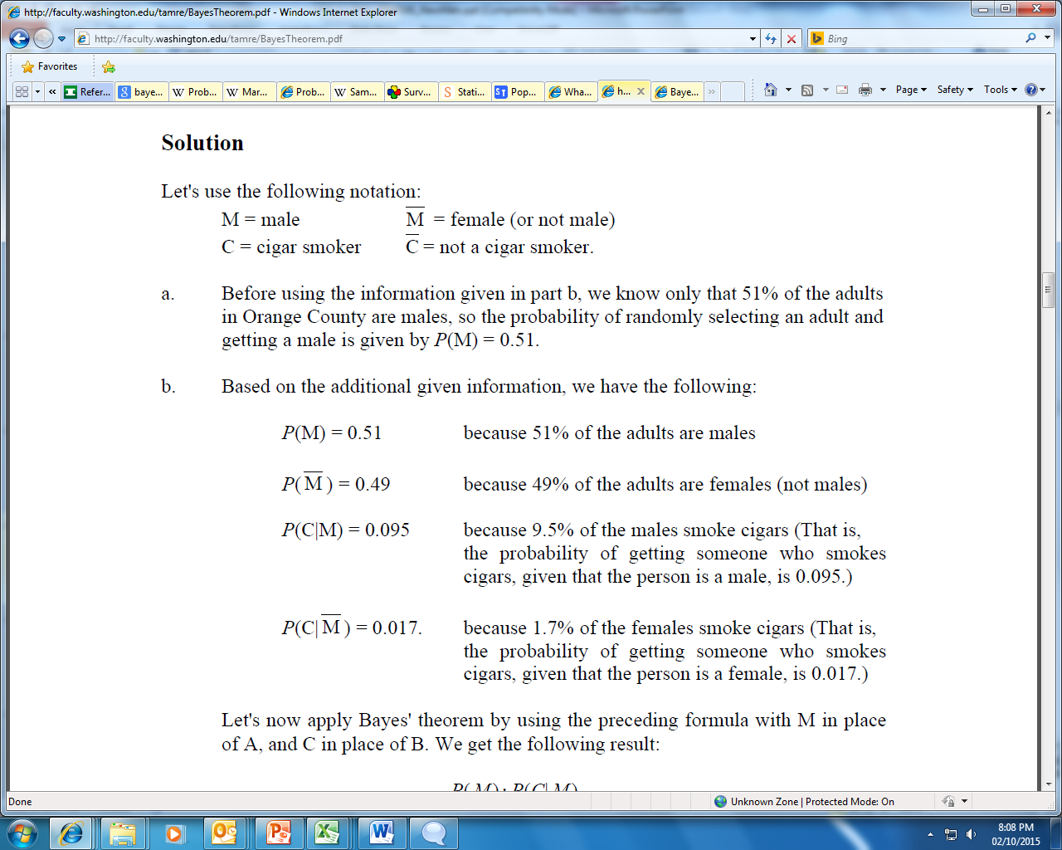

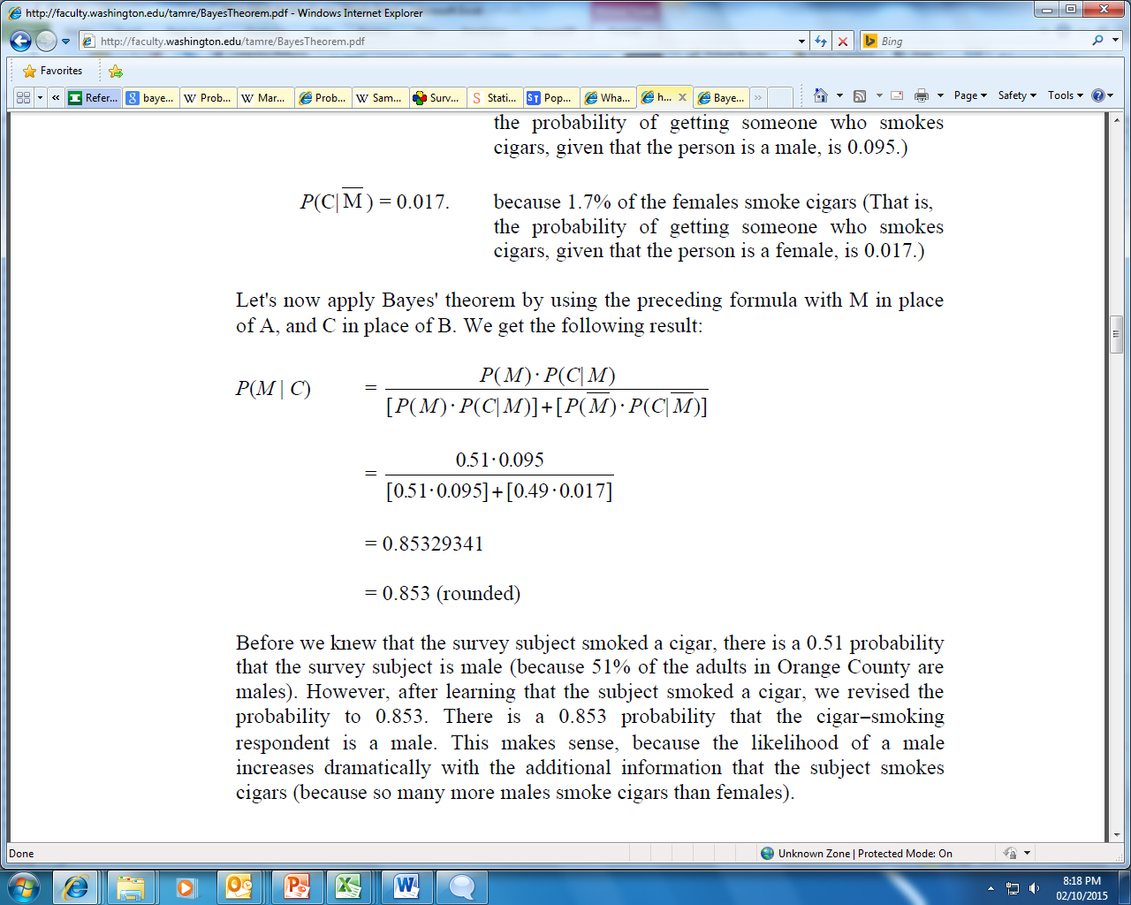
Bayes Theorem: An example…
In Boston, 51% of the adults are males. One adult is randomly selected for a survey involving credit card usage.
a) Find the probability that the selected person is a male.
b) It is later learned that the selected survey subject was smoking a cigar. Also, 9.5% of males smoke cigars, whereas 1.7% of females smoke cigars. Use this additional information to find the probability that the selected subject is a male.
Solution:
Notations:
a) Before using the information given in part b, we know only that 51% of the adults in Boston are males, so the probability of randomly selecting an adult and getting a male is given by P(M) = 0.51.
b) Using additional information provided, we get:
Using Bayes Theorem we have:
Before we knew that the survey subject smoked a cigar, there is a 0.51 probability that the survey subject is male. However, after learning that the subject smoked a cigar, we revised the probability to 0.853. There is a 0.853 probability that the cigar-smoking respondent is a male. This makes sense, because the likelihood of a male increases dramatically with the additional information that the subject smokes cigars (because many more males smoke cigars than females).

Slide 17
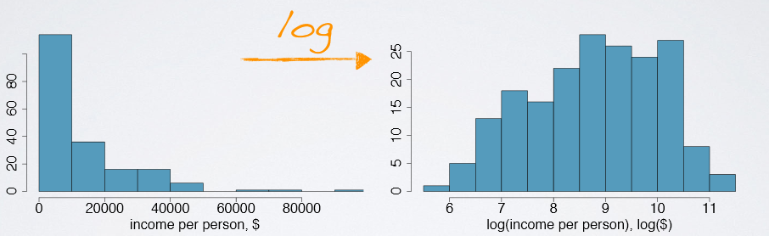
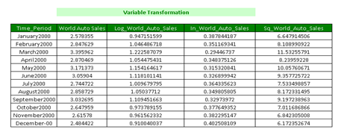
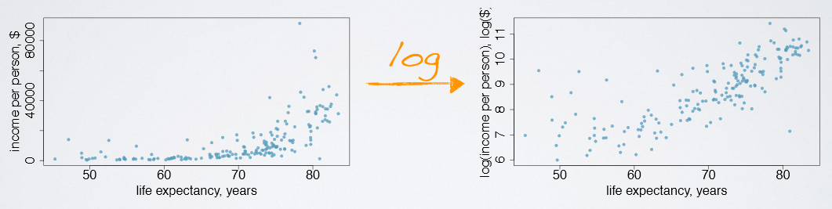
Variable Transformation
A transformation is a rescaling of the data using a function
When data are very strongly skewed, we sometimes transform them so they are easier to model
Transformations can also be applied to one or both variables in a scatterplot to make the relationship between the variables more linear, and hence easier to model with simple methods
We generally use 6 types of transformations – log, inverse, cube, cube-root, square, square-root to generate better explanatory power
Log, square-root & inverse transform positively skewed data into a more symmetric form.

Slide 18
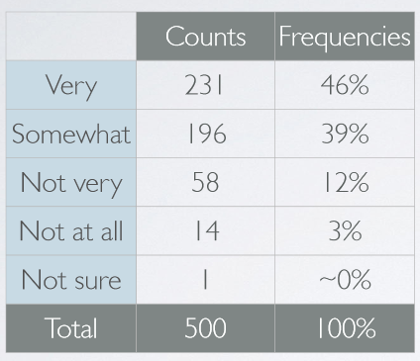
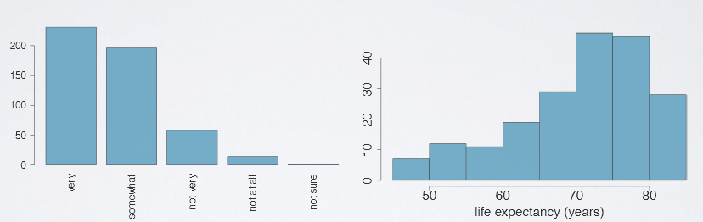
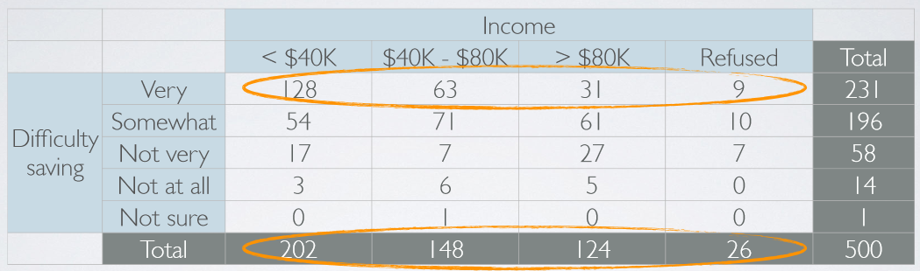
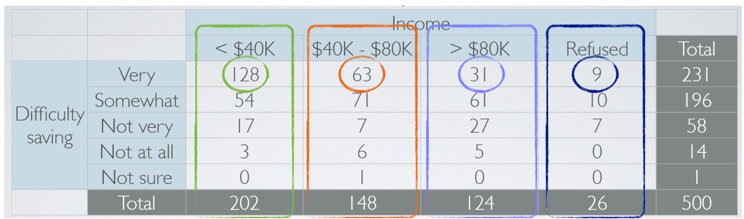
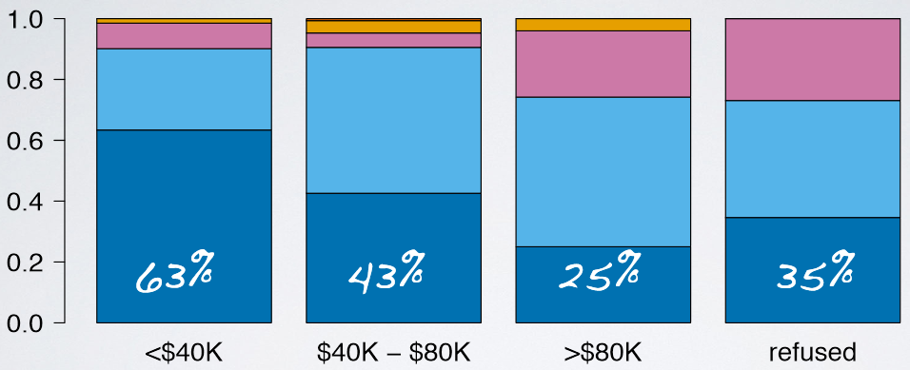
Exploring Categorical Variables
A 2014 poll in the US asked respondents how difficult they think it is to save money
Useful for visualizing conditional frequency distributions
In order to explore the relationship between the variables, we need to compare relative frequencies

Slide 19
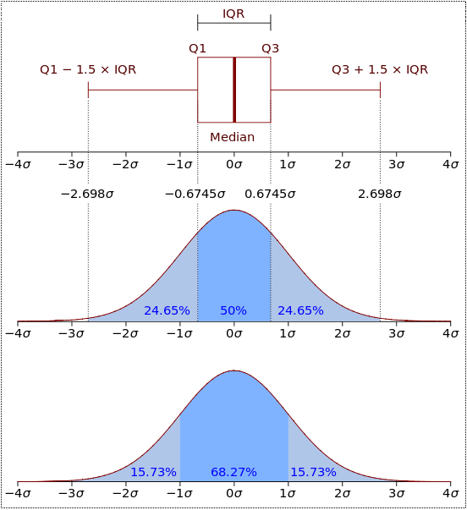
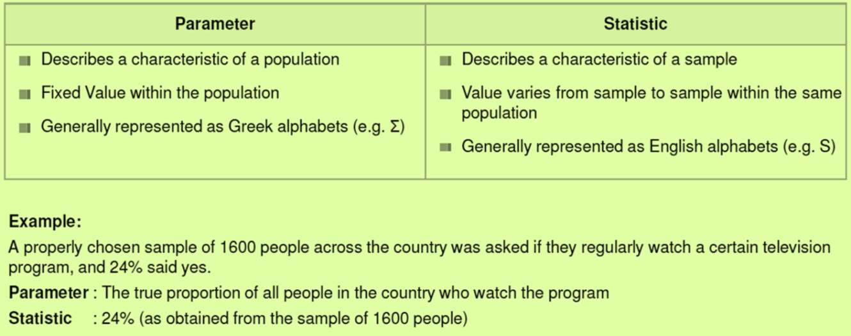
Distribution…parameter…statistics !!
A Probability Distribution assigns a probability to each measurable subset of the possible outcomes of a random experiment, survey, or procedure of statistical inference.
In probability theory, a Probability Density Function (PDF), or density of a continuous random variable, is a function that describes the relative likelihood for this random variable to take on a given value. The probability of the random variable falling within a particular range of values is given by the integral of this variable’s density over that range. The probability density function is nonnegative everywhere, and its integral over the entire space is equal to one.
Continuous distributions describe an infinite number of possible data values.
Example: Normal Distribution, Chi-Square Distribution, Student’s T Distribution
Discrete distributions describe a finite number of possible values.
Example: Binomial Distribution, Poisson Distribution
Parameters are numbers that summarize data for an entire population.
Statistics are numbers that summarize data from a sample, i.e. some subset of the entire population.
Parameters are usually unknown and estimated using statistics from sample.
Notes:
https://www.youtube.com/watch?v=YUfUp5DDhWg (Probability Distribution)

Slide 20
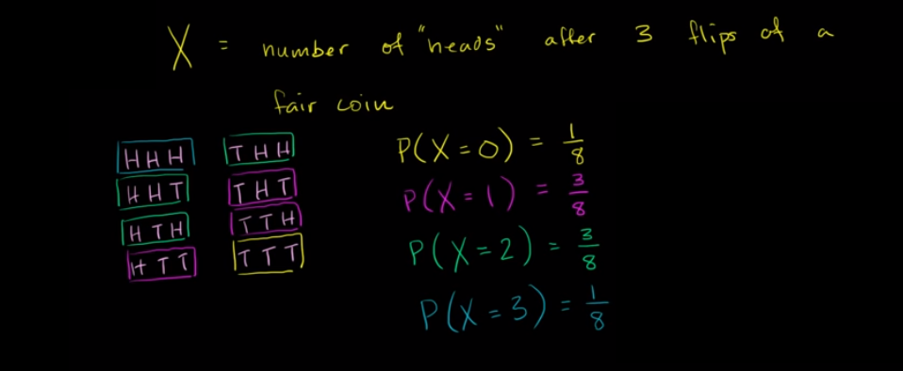
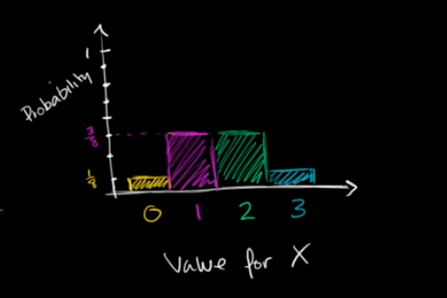
Discrete Probability Distribution: Probability Mass Function
Notes:
https://www.khanacademy.org/math/ap-statistics/random-variables-ap/discrete-random-variables/v/discrete-probability-distribution

Slide 21
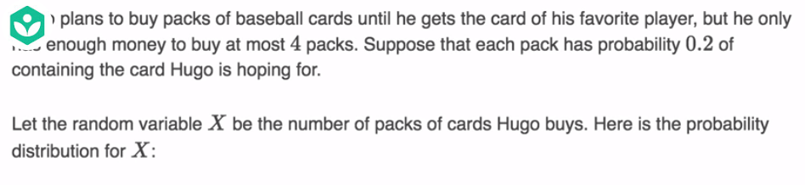

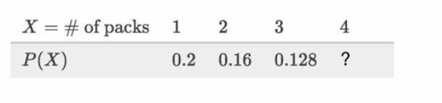
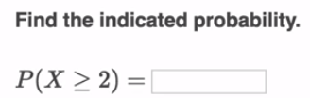
Discrete Probability Distribution: Example

Slide 22
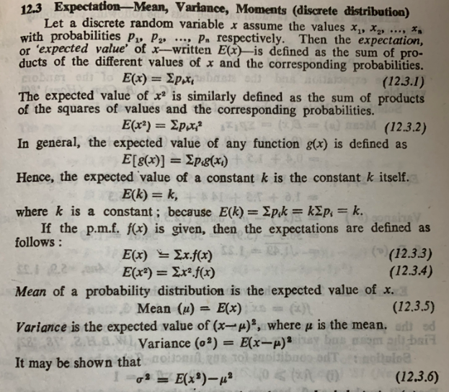
Expectations: Mean & Variance (1/2)

Slide 23
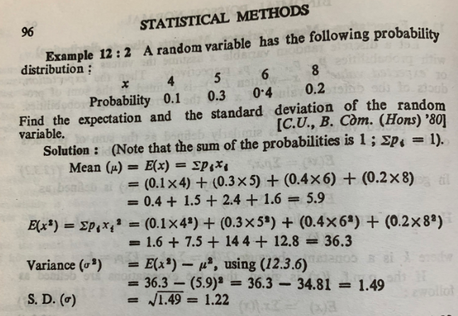
Expectations: Mean & Variance (1/2)

Slide 24
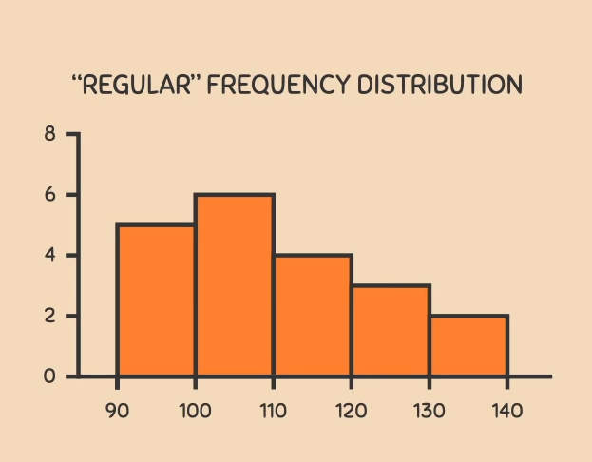
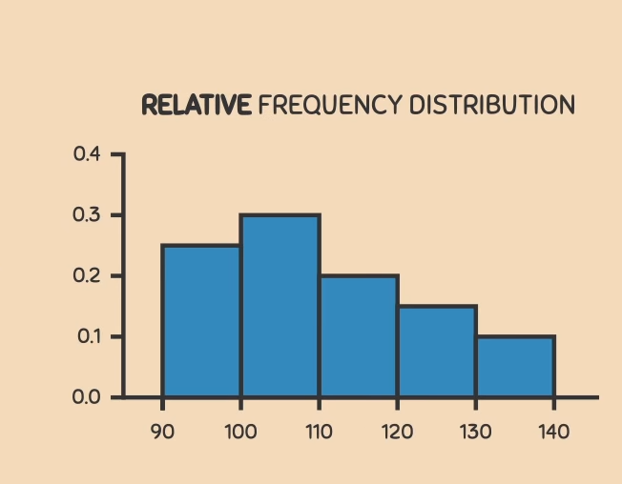
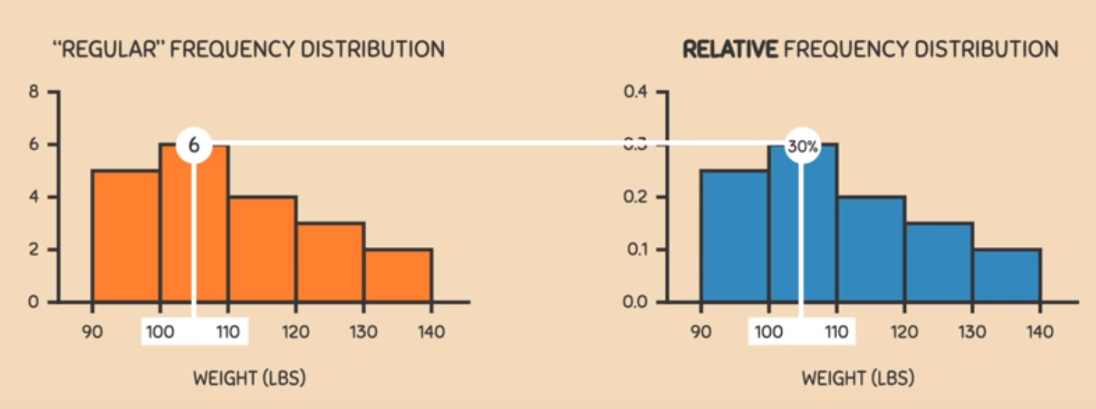
Density Curves – What are they & Where they are coming from?
Proportions of Individuals
N = 20
Weights in lbs
Notes:
https://www.youtube.com/watch?v=Txlm4ORI4Gs

Slide 25
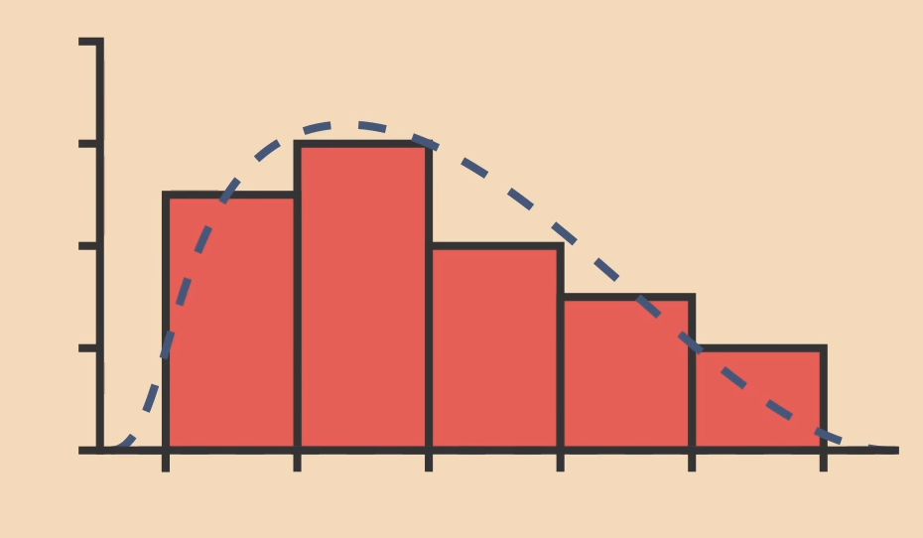
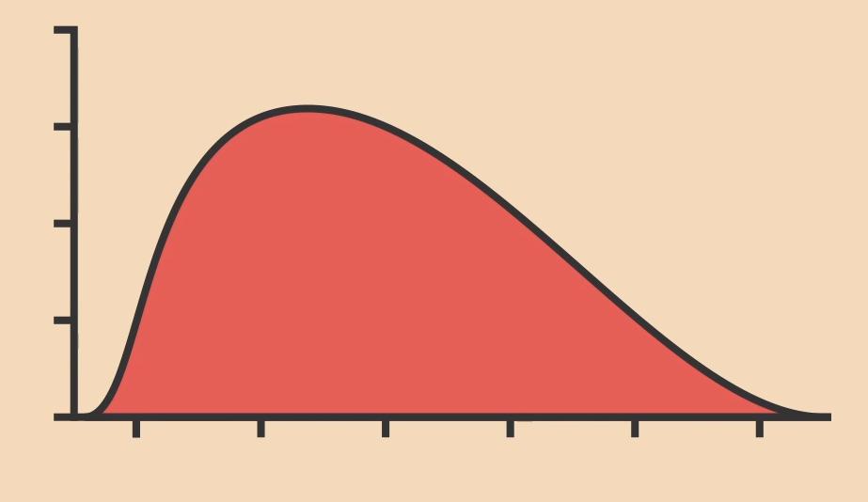
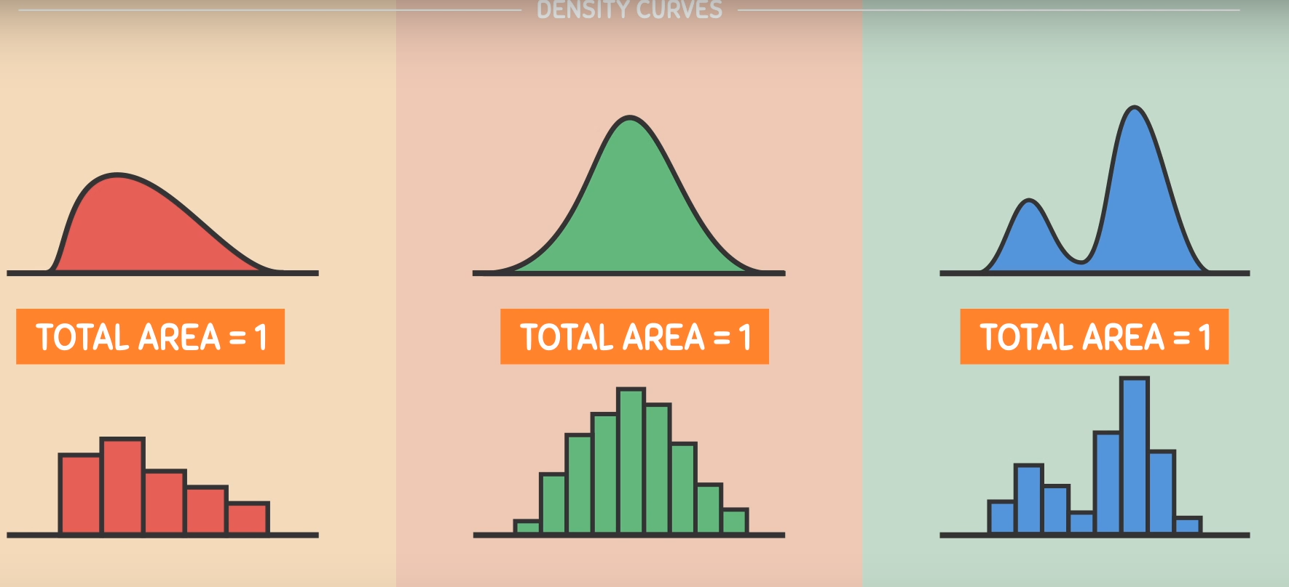
Where it is coming from – A Curve around the histogram itself…
Uses of Histograms
Histograms depends upon how we construct it and depends upon number of intervals we are considering
Density curves consider infinite amount of intervals – Independent
Uses of density curves – more popular
Notes:
https://www.youtube.com/watch?v=Txlm4ORI4Gs

Slide 26
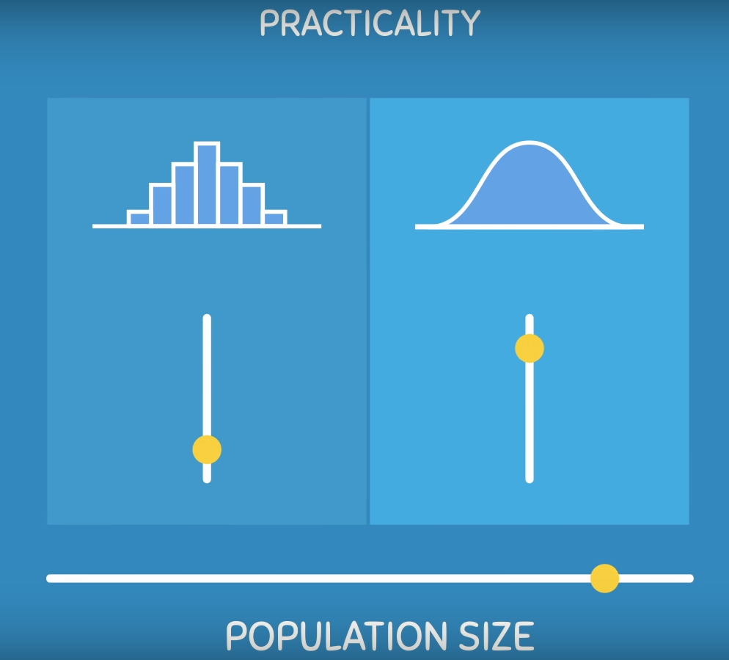
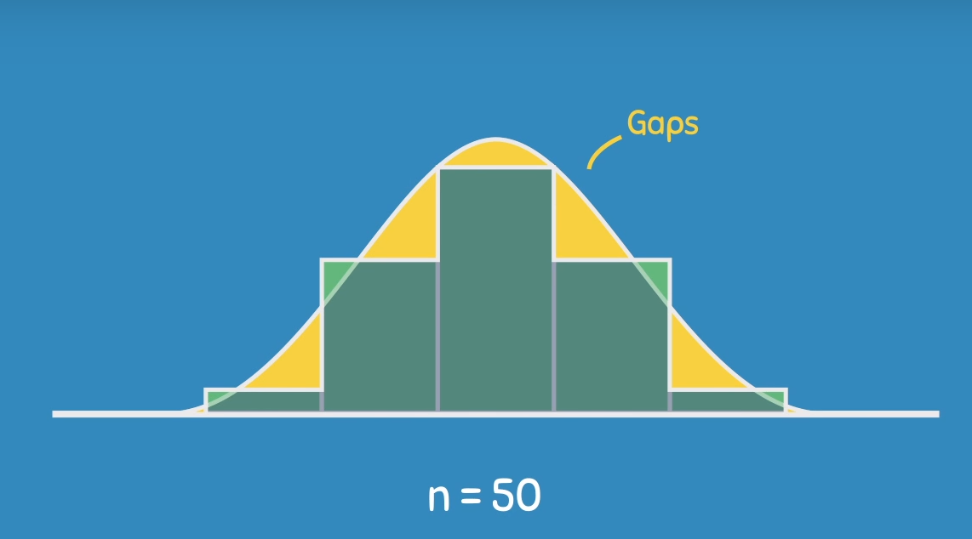
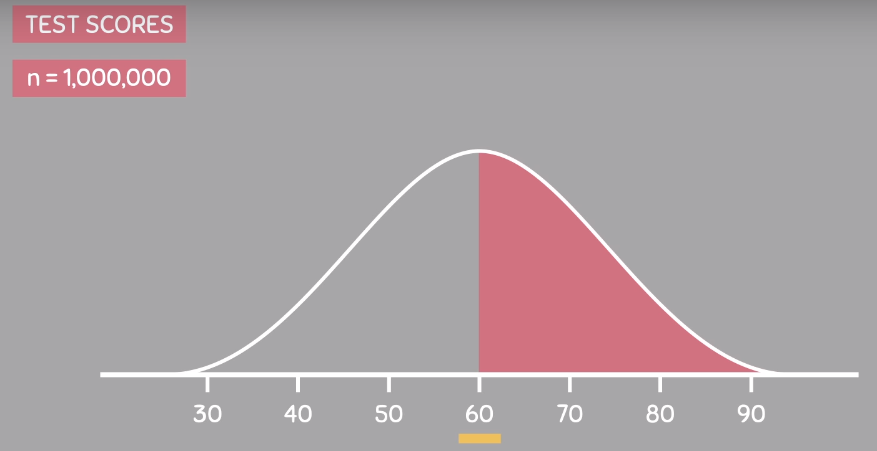

Uses of Density Curves – As Population/Sample size increases…
Might be inaccurate on small sample
Area of Interest
Notes:
https://www.youtube.com/watch?v=Txlm4ORI4Gs

Slide 27


Continuous Probability Distribution Contd. – Area of a distribution
Might be inaccurate on small sample
Area = 1 or 100%
Probability of occurrence of any exact value = 0
Notes:
https://www.youtube.com/watch?v=Txlm4ORI4Gs

Slide 28


Uniform Distribution Discrete
In probability theory and statistics, the discrete uniform distribution is a symmetric probability distribution whereby a finite number of values are equally likely to be observed; every one of n values has equal probability 1/n. Another way of saying "discrete uniform distribution" would be "a known, finite number of outcomes equally likely to happen".
A simple example of the discrete uniform distribution is throwing a fair dice. The possible values are 1, 2, 3, 4, 5, 6, and each time the dice is thrown the probability of a given score is 1/6. If two dice are thrown and their values added, the resulting distribution is no longer uniform since not all sums have equal probability. Although it is convenient to describe discrete uniform distributions over integers, such as this, one can also consider discrete uniform distributions over any finite set. For instance, a random permutation is a permutation generated uniformly from the permutations of a given length, and a uniform spanning tree is a spanning tree generated uniformly from the spanning trees of a given graph.

Slide 29


Bernoulli Distribution
A Bernouilli distribution is a discrete probability distribution for a Bernouilli trial — a random experiment that has only two outcomes (usually called a “Success” or a “Failure”)
For example, the probability of getting a heads (a “success”) while flipping a coin is 0.5. The probability of “failure” is 1 – P (1 minus the probability of success, which also equals 0.5 for a coin toss).
It is a special case of the binomial distribution for n = 1. In other words, it is a binomial distribution with a single trial (e.g. a single coin toss).

Slide 30



Binomial Distribution
Binomial Distribution: This probability distribution describes the probability of having exactly ‘k’ successes in ‘n’ independent Bernoulli trials with probability of success ‘p’

Slide 31



Binomial Distribution - Example
Notes:
https://www.youtube.com/watch?v=Iu25wy7icok
https://stattrek.com/probability-distributions/binomial.aspx

Slide 32


Poisson Distribution
Poisson Distribution: A probability distribution that arises when counting the number of occurrences of a rare event in a long series of trials.
Where --- m : average rate of value
x : Poisson random variable
e : Base of logarithm(e=2.718)
Used to model the rates of occurrence of an event , that is the number of occurrences in a unit of measure
Events can happen at any point along a continuum
At any particular point, the probability of an event is small
The average number of events is constant over a unit of measure
Independent events
One parameter (m : the average number of events in a unit of measure)

Slide 33


Poisson Distribution – Example (1/2)
Notes:
https://www.khanacademy.org/math/statistics-probability/random-variables-stats-library/poisson-distribution/v/poisson-process-1

Slide 34


Poisson Distribution – Example (2/2)

Slide 35
Density Curves – What are they & Where they are coming from?
Proportions of Individuals
N = 20
Weights in lbs
Notes:
https://www.youtube.com/watch?v=Txlm4ORI4Gs

Slide 36
Where it is coming from – A Curve around the histogram itself…
Uses of Histograms
Histograms depends upon how we construct it and depends upon number of intervals we are considering
Density curves consider infinite amount of intervals – Independent
Uses of density curves – more popular
Notes:
https://www.youtube.com/watch?v=Txlm4ORI4Gs

Slide 37
Uses of Density Curves – As Population/Sample size increases…
Might be inaccurate on small sample
Area of Interest
Notes:
https://www.youtube.com/watch?v=Txlm4ORI4Gs

Slide 38
Continuous Probability Distribution Contd. – Area of a distribution
Might be inaccurate on small sample
Area = 1 or 100%
Probability of occurrence of any exact value = 0
Notes:
https://www.youtube.com/watch?v=Txlm4ORI4Gs

Slide 39

Practice Questions - 1
Notes:
https://www.youtube.com/watch?v=Txlm4ORI4Gs

Slide 40


Practice Questions - 2
Notes:
https://www.youtube.com/watch?v=Txlm4ORI4Gs

Slide 41

Practice Questions - 3
Notes:
https://www.youtube.com/watch?v=Txlm4ORI4Gs

Slide 42

Normal Distribution – What it is so practical and common?
Notes:
https://www.youtube.com/watch?v=Txlm4ORI4Gs

Slide 43







Normal Distribution – A special type of density curve
Mean – Position of bell curve
Standard deviation – Shape/Spread of bell curve
Notes:
https://www.youtube.com/watch?v=mtbJbDwqWLE

Slide 44



Normal Distribution – the 68-95-99.7 Rule
Notes:
https://www.youtube.com/watch?v=Txlm4ORI4Gs

Slide 45






Normal Distribution – the 68-95-99.7 Rule contd..
Notes:
https://www.youtube.com/watch?v=Txlm4ORI4Gs

Slide 46

Practice Questions - 1
Notes:
https://www.youtube.com/watch?v=Txlm4ORI4Gs

Slide 47

Practice Questions - 1
Notes:
https://www.youtube.com/watch?v=Txlm4ORI4Gs

Slide 48




Standard Normal Distribution – A special type of Normal Distribution
2 s.d. right from mean
Mean – 0
Standard deviation - 1
2 s.d. left from mean
Notes:
https://www.youtube.com/watch?v=mtbJbDwqWLE

Slide 49


Standard Normal Distribution – How & Why do we calculate Z-Scores
Any Normal distribution can be converted into Standard normal distribution
Mean – 0
Standard deviation - 1
Notes:
https://www.youtube.com/watch?v=mtbJbDwqWLE

Slide 50



Standard Normal Distribution – Area of Z-scores
Mean – 0
Standard deviation - 1
Rows and Columns Z-Scores
Area (percentiles/percentage values inside the tables
Notes:
https://www.youtube.com/watch?v=mtbJbDwqWLE

Slide 51




Standard Normal Distribution – How do we calculate Z-Scores contd…
Any Normal distribution can be converted into Standard normal distribution
Mean – 0
Standard deviation - 1
Notes:
https://www.youtube.com/watch?v=mtbJbDwqWLE

Slide 52

Practice Questions - 1
Notes:
https://www.youtube.com/watch?v=Txlm4ORI4Gs

Slide 53



Z-Scores – A more practical use.. To compare two groups
Case:
A college admissions officer wants to determine which of the two applicants scored better on their standardized test with respect to the other test takers: Pam, who earned a 1800 on her SAT, or Jim, who scored a 24 on his ACT?
SAT scores ~ N(mean=1500, SD=300) ; ACT ~ N(mean=21, SD=5)
Mean – 0
Standard deviation - 1
Key Points :
Z-score of mean =0
Unusual observation :|Z| > 2
Defined for distributions of any shape
Comparing the SAT and ACT scores using standardized
Z-score indicates that indeed Pam has scored better
than Jim. This is illustrated by the fact that Pam’s scores are further away (higher S.D. of 1) from the mean than Jim’s score, thus positioned at a score point that is more than Jim’s.
Notes:
https://www.youtube.com/watch?v=mtbJbDwqWLE

Slide 54


Normal approximation of Binomial and Poisson Distributions
Normal Approximation to Binomial Distribution
With increasing number of trials (‘n’) and probability of success(‘p)’ becoming smaller the skewed Binomial distribution tends to be approximated by a normal distribution. The Success - Failure rule is imperative for the binomial distribution to follow the normal distribution, given as
n> 40 : n*p >=10 and n*P*(1-p) >=10
Normal Approximation to Poisson Distribution
With increasing value of mean(‘m’) the right skewed Poisson distribution tends to be approximated by a normal distribution. The rule for the Poisson to follow a Normal distribution is
m>10
Notes:
https://www.youtube.com/watch?v=k9nRcadQYsU (The Normal Approximation of the Binomial Distribution)

Slide 55






Central Limit Theorem - Visual
Notes:
https://www.youtube.com/watch?v=Pujol1yC1_A (Central Limit Theorem)

Slide 56
Central Limit Theorem
Simply put, Central Limit Theorem states that the distribution of sample statistics of a large number of independent, identically distributed variables will be approximately normal, regardless of the underlying distribution
The mean of the sample means will be the mean of the population
The variance of the sample means will be the variance of the population divided by the sample size.
The standard deviation of the sample means (known as the standard error of the mean) will be smaller than the population mean and will be equal to the standard deviation of the population divided by the square root of the sample size.
If the population has a normal distribution, then the sample means will have a normal distribution.
If the population is not normally distributed, but the sample size is sufficiently large, then the sample means will have an approximately normal distribution
Assumptions:
Independence: Sampled observations must be independent.
Large sample size in case of non normal distribution
Why is the Central Limit Theorem Important?
If we know the population mean and standard deviation, we know the following will be true:
The distribution of means across repeated samples will be normal with a mean equal to the population mean and a standard deviation equal to the population standard deviation divided by the square root of n. Since we know exactly what the distribution of means will look like for a given population, we can take the mean from a single sample and compare it to the sampling distribution to assess the likelihood that our sample comes from the same population.
Notes:
https://www.youtube.com/watch?v=Pujol1yC1_A (Central Limit Theorem)

Slide 57






Correlation Concept
Correlation describes the strength of the Linear Association between two Variables. The Correlation Co-efficient is denoted by r which is always in between -1 (perfect linear negative relationship) and 1 (perfect linear positive relationship)
Absolute value measures strength
Sign indicates Direction
Not Affected by Unit Change
Corr.(Y and X) = Corr.(X and Y)
Outlier Sensitive

Slide 58






Scatter Plots…Guess the Correlation Coefficient…!!!

Slide 59


Pearson Correlation…
Pearson’s correlation coefficient is the test statistics that measures the statistical relationship, or association, between two continuous variables. It is known as the best method of measuring the association between variables of interest because it is based on the method of covariance. It gives information about the magnitude of the association, or correlation, as well as the direction of the relationship
Limit: Coefficient values can range from +1 to -1, where +1 indicates a perfect positive relationship, -1 indicates a perfect negative relationship, and a 0 indicates no relationship exists..
Pure number: It is independent of the unit of measurement. For example, if one variable’s unit of measurement is in inches and the second variable is in quintals, even then, Pearson’s correlation coefficient value does not change.
Symmetric: Correlation of the coefficient between two variables is symmetric. This means between X and Y or Y and X, the coefficient value of will remain the same.
Degree of correlation:
Perfect: If the value is near ± 1, then it said to be a perfect correlation: as one variable increases, the other variable tends to also increase (if positive) or decrease (if negative).
High degree: If the coefficient value lies between ± 0.50 and ± 1, then it is said to be a strong correlation.
Moderate degree: If the value lies between ± 0.30 and ± 0.49, then it is said to be a medium correlation.
Low degree: When the value lies below + .29, then it is said to be a small correlation.
No correlation: When the value is zero.
Notes:
https://www.youtube.com/watch?v=6fUYt1alA1U
https://www.youtube.com/watch?v=2SCg8Kuh0tE

Slide 60



Rank Correlation…
Notes:
https://www.youtube.com/watch?v=0WejW9MiTGg

Slide 61

Rank Correlation: Quick Maths…

Slide 62


Regression Analysis…
Y and X largely obey an approximately linear relationship
How to fit a line to describe the ”broadly linear” relationship between Y and X when the (x, y) pairs do not all lie on a straight line?
Consider the pairs (xi,yi)
Let ˆyi be the predicted value of yi
ei = yi- ˆyi as the residual representing the error involved
Several approaches are there to minimize the error :
1. Minimize the sum of the errors
2. Minimize the sum of the absolute error
3. Least square method
Notes:
https://www.youtube.com/watch?v=zPG4NjIkCjc

Slide 63

Regression Analysis…
Lets take a data of 60 families with their weekly income & weekly consumption expenditure.
The 60 families are divided into 10 income groups and the weekly consumption expenditure of each family in each income group is shown below:
There is considerable variation in the weekly consumption expenditure in each income group. The general picture is that, despite the variability, on an average the weekly consumption expenditure increases as income increases.
In the above case, we see that E(Y/Xi) is a linear function of Xi (i.e. expenditure is linearly related to income)
E(Y/Xi) = β1 + β2Xi (where β1 & β2 are also known as intercept and the slope coefficients respectively)

Slide 64


Parameter v/s Statistics – Revisit..
Notes:
https://www.youtube.com/watch?v=Txlm4ORI4Gs

Slide 65








Central Limit Theorem – Where it is applicable?
Notes:
https://www.youtube.com/watch?v=YAlJCEDH2uY

Slide 66














Parameter v/s Statistics – Revisit..
Notes:
https://www.youtube.com/watch?v=YAlJCEDH2uY

Slide 67







P-values – What are they and where they are coming from?
Definition of p-value
Notes:
https://www.youtube.com/watch?v=5Z9OIYA8He8

Slide 68




P-values – represented with respect to critical region…
Notes:
https://www.youtube.com/watch?v=5Z9OIYA8He8

Slide 69






Hypothesis Testing – Formulation
Hypothesis
Sample 1
Sample 2
Q- Is 168.4 far enough from 175 (Mean) for us to be able to reject our hypothesis??
Theoretically, it looks like 174.6 (1st Sample) is not very far from 175 but 168.4 (2nd Sample) looks a bit far from 175
To answer this statistically – we will only reject our hypothesis if 168.4 or 174.6 fall into reject region
168.4
174.6
175
2
1
Note - Hypothesis is all about parameters not statistics
Notes:
https://www.youtube.com/watch?v=zR2QLacylqQ (Follow all the subsections related to this topic)

Slide 70




Hypothesis Testing – Formulation contd…
Hypothesis
Sample 1
Sample 2
Q- Is 34 far enough or different from 31 (Mean) for us to be able to reject our hypothesis??
Theoretically, it looks 34 (1st Sample) is not different from actual mean(random chance) but 34 (2nd Sample), where sample size is 200 looks different from actual
To answer this statistically – we will only reject our hypothesis if 168.4 or 174.6 fall into reject region
2
34
1
34
175
Note – Sample size is drastically different between two samples
If null hypothesis is true, How extreme is our sample?

Slide 71




Hypothesis Testing – If H0 is true, how extreme is our sample?
Always a trade-off between type I error and type II error
Power of a test – Probability of rejecting the H0 (null hypothesis) when it is false
Q - Why we always want to reject the null hypothesis?

Slide 72





Hypothesis Testing for – When is known
1
Note – The alternative hypothesis (H1) contains values for which we are seeking evidence for
Since we start with a counter here and collect the evidence (against it) null hypothesis, and based on that we reject the null or do not reject the null (never accept the null)
Criminal Trial example – H0: "the defendant is not guilty"
H1: "the defendant is guilty"

Slide 73






Hypothesis Testing for – When is known
2
3
But where is the evidence against the null or 1.8856 is too far from mean?
5
4
3a

Slide 74


Hypothesis Testing for – When is known
1
Note – The alternative hypothesis (H1) contains values for which we are seeking evidence for
Since we start with a counter here and collect the evidence (against it) null hypothesis, and based on that we reject the null or do not reject the null (never accept the null)
Criminal Trial example – H0: "the defendant is not guilty"
H1: "the defendant is guilty"

Slide 75





Hypothesis Testing for – When is known
2
3
But where is the evidence against the null or -2.191 is too far from mean?
5
4
3a

Slide 76



t Distribution – The problem with small samples
If the underlying distribution in normal and standard deviation is known, then sample mean will also follow normal distribution ~

Slide 77








t Distribution – Formulation and Visualization

Slide 78

Practice Question - 1

Slide 79

Practice Question - 2

Slide 80


Hypothesis Testing for – When is unknown
1
Note – The alternative hypothesis (H1) contains values for which we are seeking evidence for
Since we start with a counter here and collect the evidence (against it) null hypothesis, and based on that we reject the null or do not reject the null (never accept the null)
Criminal Trial example – H0: "the defendant is not guilty"
H1: "the defendant is guilty"

Slide 81








Hypothesis Testing for – When is unknown
2a
But where is the evidence against the null -0.557 is too far from mean?
2
4
3a
3
5

Slide 82



Confidence Interval – Introduction
Notes:
https://www.youtube.com/watch?v=hlM7zdf7zwU

Slide 83

Confidence Interval – Contd..

Slide 84
Summary of Testing Tables
 | Jury Trial |  |  | Hypothesis Test
 | Actual Situation |  |  | Actual Situation
Verdict | Innocent | Guilty | Decision | H₀ True | H₀ False
Innocent | Correct | Error (II) | Do not reject H₀ | 1- α | Type II error (β)
Guilty | Error (I) | Correct | Reject H₀ | Type I error (α) | Power (1- β)
Type I Error
Rejecting True Null Hypothesis (“False Positive”)
Probability of Type I error is
Called Level of Significance
Set by researcher; provides critical values for the test
Called Rejection Region of Sampling Distribution / Typical values are 0.01, 0.05, 0.10
Type II Error
Do not reject False Null Hypothesis (“False Negative”)
Probability of Type II error is β
α

Slide 85
Z Test
Perform z test when:
Random sample follows a Normal distribution
Mean is known
Population standard deviation is known
Large sample (n>= 30)
Z test can be used
For testing mean of single sample
For testing means of two independent samples
Notes:
https://www.youtube.com/watch?v=5ABpqVSx33I (Z and T)

Slide 86
Z Tests - Example
Maxwell’s Hot Chocolate is concerned about the effect of the recent years long coffee advertising campaign on hot chocolate sales. The average hot chocolate sales two years ago was 984.7 pounds and the standard deviation was 99.6 pounds.
Maxwell randomly selected 30 weeks from the past year and found average sales to be 967.1 pounds.
Test: a. Whether the hot chocolate sales have decreased?
b. At 5% level of significance help the Maxwell hot chocolate to take a decision?
Ho: μ = 984.7 vs. H1: μ < 984.7
Under Ho, the test statistics is:
Numerator : 967.1 – 984.7 = -17.6
Denominator: 99.6 / SQRT(30)
Ζ = -0.96 p value = <0.0001
What do we conclude?
The result is significant at p < .05 : Reject the Null Hypothesis
Note: In Excel Use NORMSDIST function to compute the p value.

Slide 87
T Test
The t test tells you how significant the differences between groups are; In other words it lets you know if those differences (measured in means/averages) could have happened by chance.
Perform t test when:
Random sample follows a Normal distribution
Mean is known
Population Variance is unknown
Small sample (n< =30)
T test can be used
For testing mean of single sample
For testing means of two independent samples
Difference between means of dependent sample

Slide 88


T Tests - Example
You seek to determine whether differences exist in monthly sales between the new package design and the old package design of a laundry stain remover. The new package was test marketed over a period of one month in a sample of supermarkets in a particular city.
A random sample of ten pairs of supermarkets was matched according to weekly sales volume and a set of demographic characteristics. The data collected for this study are as follows:
New Package = Score1
Old Package = Score
Subject: Supermarket

Slide 89




T Tests – Example Cont.
Note: In Excel, use the TTEST function to compute the p value.

Slide 90
F Test
Perform F test when:
Populations from which the random samples are drawn are normal and independent
Let s₁²and s₂² be the sample variances
F test can be used
to test the hypothesis of equality of two population variances
to test for equality of several means is carried out by the technique named ANOVA
to test the significance of the regression model

Slide 91

F Test: Example
Two chemical companies supply a raw material. The concentration of a particular element in this material is
important. The mean concentration for both suppliers is the same, but we suspect that the variability in concentration may differ between the two companies.
The standard deviation of
concentration in a random sample of n1=10 batches produced
by company 1 is s1 = 4.7 grams per liter, while for company 2, a random sample of n2 = 16 batches yields s2= 5.8 grams per liter.
Is there sufficient evidence to conclude that the two population variances differ?
Ho : σ1² = σ2² vs.
Ha : σ1² σ2²
Under Ho, the test statistics
F = 0.6577
df = 9, 15
p value = 0.733
What should we infer?
Since p value >0.05, we do no have enough evidence to reject the hypothesis.
Notes:
https://www.youtube.com/watch?v=FlIiYdHHpwU

Slide 92
F Test: Example Cont.
A fuel-economy study was conducted for two German automobiles, Mercedes and Volkswagen. One vehicle of each brand was selected, and the mileage performance was observed for 10 tanks of fuel in each car.
Is there evidence to support the claim that the variability in mileage performance is lesser for a Mercedes than for a Volkswagen?
Mercedes | Volkswagen
24.7 | 41.7
24.8 | 42.3
24.9 | 41.6
24.7 | 39.5
24.5 | 41.9
24.9 | 42.8
24.6 | 42.4
24.6 | 39.9
24.9 | 40.8
24.8 | 39.6
How should we frame the hypothesis?
Ho : σ1² < = σ2² vs.
Ha : σ1² > σ2²
Under the null hypothesis, the test statistics is:
F =0.0137 with df = 9,9
p value = 2.50E-07
What do we infer?
Notes:
https://www.youtube.com/watch?v=Xg8_iSkJpAE

Slide 93


ANOVA Test: Build Up SST
Total Sum of Square: 30
Degrees of Freedom: (m * n) – 1 = 8
NULL Hypothesis: All the group means are equal
ALT Hypothesis: At least one is not Equal
Grand Mean = 4
Notes:
https://www.youtube.com/watch?v=Xg8_iSkJpAE

Slide 94


ANOVA Test: Build Up SSW and SSB
Within Sum of Square: 6
Degrees of Freedom: (n-1) * # of Groups = 3 * 2 = 6
Grand Mean = 4
Between Sum of Square: 24
Degrees of Freedom: (n-1) * # of Groups = m-1 = 2

Slide 95


ANOVA Test: F Statistic
F Value = (SSB / DF of SSB) / (SSW / DF of SSW)
= (24/2) / (6/6) = 12
F Score = 3.46330
Reject the NULL Hypothesis

Slide 96
Chi Square Tests
Categorical data lead to counts within each category
Tests the association/ independence between nominal(categorical) variables
Null Hypothesis: The 2 variables are independent
Tests the homogeneity between categorical variables
Measure of goodness-of -fit
Its really just a comparison between expected frequencies and observed frequencies among the cells in a cross tabulation table

Slide 97
Requirements for Chi-Square test
Must be a random sample from population
Data must be in raw frequencies
Variables must be independent
Categories for each cell must be mutually exclusive and exhaustive
Using the Chi-Square Test
Often used with contingency tables (i.e., cross tabulations)
•E.g., gender x race
Basically, the chi-square test of independence tests whether the columns are contingent on the rows in the table.
•In this case, the null hypothesis is that there is no relationship between row and column frequencies.
Notes:
https://www.youtube.com/watch?v=2QeDRsxSF9M

Slide 98
Example
Fast-food chains are evaluated on many variables and the results are summarized periodically in QSR Magazine. One important variable is the accuracy of the order.
You seek to determine, with a
level of significance of α = 0.05, whether a difference exists in the proportions
of food orders filled correctly at Burger King, Wendy’s, and McDonald’s.
How will you frame the hypothesis?
Ho: No difference exists in the proportion of correct orders among Burger King, Wendy’s, and McDonald’s.
H1: A difference exists in the proportion of correct orders among Burger King, Wendy’s, and McDonald’s
Under Ho the test statistics is as follows:
 | Fast Food Chain
 |  | Burger King | Wendy’s | McDonald’s | Total
Order Filled Correctly | Yes | 440 | 430 | 422 | 1292
 | No | 60 | 70 | 78 | 208
 | Total | 500 | 500 | 500 | 1500
 | Expected Frequencies
 |  | Burger King | Wendy’s | McDonald’s
Order Filled Correctly | Yes | 431 | 431 | 431
 | No | 69 | 69 | 69
 | Total | 500 | 500 | 500

Slide 99





Example2

Slide 100
Summary of Parametric Test
stats

